Slide 1
Pottali Kalpana
Pottali Kalpana is a traditional Ayurvedic medicinal preparation that involves the processing of mercury and other substances into a compact and potent form. This presentation explores the significance, history, preparation, and applications of Pottali Kalpana, highlighting its unique features and contributions to Ayurvedic medicine.
by Dr. SREEJITH E.G
Dept. Of Rasashastra and Bhaishajya Kalpana

Slide 2
Importance Of Rasashastra
1
Subject of Mercury
Rasashastra is the branch of Ayurveda that deals with mercury, its allied substances, and their therapeutic applications.
2
Therapeutic Benefits
Rasa kalpas, preparations involving mercury, are highly valued for their effectiveness in treating various ailments. They are known for their potency, palatability, and ability to quickly address disease pathology.
3
Concise and Compact
The term "Pottali" signifies a concise and compact form, reflecting the essence of this preparation method. It involves minimizing and consolidating scattered materials into a concentrated and manageable form.

Slide 3
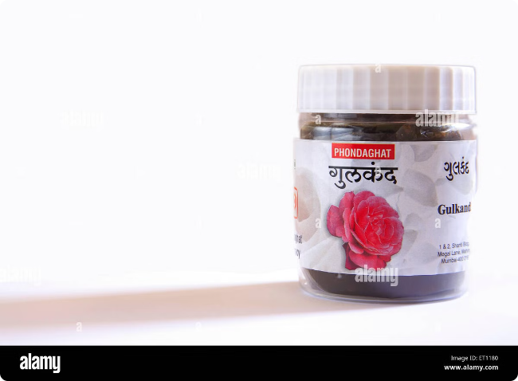
Idea Behind The Conception Of Pottali
Minimization
The word "Pottali" signifies the concept of minimizing, condensing, and making materials compact.
Collection and Consolidation
Pottali Kalpana involves collecting scattered materials and transforming them into a compact and comprehensive form.
Compactness
The process of Pottali Kalpana aims to achieve compactness, ensuring that the medicinal properties are concentrated and readily available for therapeutic use.

Slide 4
History
1
12th Century
Early texts like Rasaratnakara, Rasa prakasha sudhakara, and Rasayogasagara Vol-II mention Pottali Kalpana.
2
13th-18th Centuries
Further development and refinement of Pottali Kalpana occurred through texts like Yogaratnakara, Sharangadhara samhita, Siddha bheshaja manimala, and Bhaishajya Ratnavali.
3
Modern Era
The legacy of Pottali Kalpana continues today, with numerous texts and practitioners preserving and utilizing this ancient Ayurvedic preparation method.

Slide 5
Different Method Of Preparation
Putapaka
Gandhaka Drava Paka
Bhavana Vidhi
The Putapaka method involves heating the Pottali in a sealed container, often using a sand bath, to facilitate the transformation of the ingredients.
This method involves boiling the Pottali in melted sulfur, allowing the sulfur to penetrate and interact with the ingredients.
Bhavana Vidhi involves trituration, where the ingredients are ground together with a liquid medium, such as herbal juices, to enhance their properties.

Slide 6
Specifications
Ingredients
Parada (Mercury), Gandhaka (Sulfur), Lohadi varga (Iron group metals)
Binding Agents
Kumari swarasa (Aloe vera juice), Babbula niryasa (Acacia gum)
Shape
Pooga phala (Areca nut), Shikharakara (Conical)
Container
Loha patra (Iron vessel), Mrittika patra (Clay vessel)
Cloth
Silk cloth
Yantra
Valuka yantra (Sand bath)
Paka lakshana
Neelashyama varna (Blue-black color), Metallic sound, Burning of silk cloth
Paka kala
1-8 hours
Paschat karma
Polishing of Pottali

Slide 7
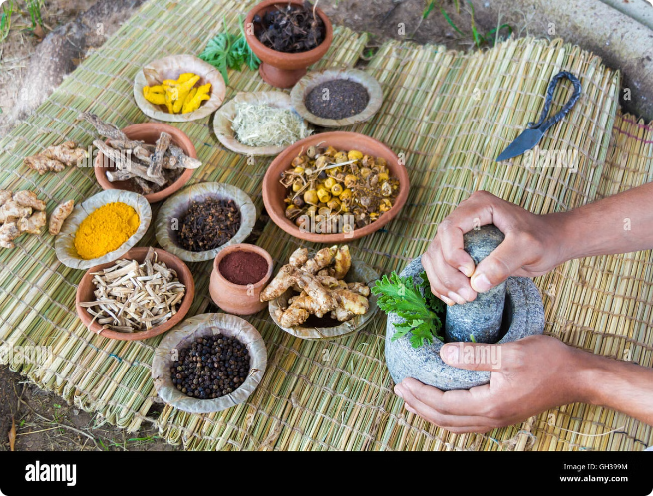
Procedure
Poorva Karma
This initial stage involves identifying and collecting raw materials, purifying them, preparing kajjali (a mercury-sulfur compound), arranging the sand bath, and gathering necessary materials like thread and silk cloth.
Pradhana Karma
The main stage involves the actual preparation of the Pottali. The ingredients are triturated with binding agents, shaped into a desired form, dried, wrapped in silk cloth, and placed in the sand bath for heating.
Paschat Karma
After the heating process, the Pottali is removed, cooled, and polished. The final product is examined for its characteristics, such as metallic sound, hardness, luster, and color.

Slide 8
Significance
Easy Administration
Pottali Kalpana offers a convenient and easy way to administer potent medicinal substances.
Life-Saving Remedy
Pottali preparations are considered life-saving remedies for various acute conditions.
Long Shelf Life
Pottali preparations have a long shelf life, ensuring their availability for extended periods.
Easy Absorption
Pottali preparations are designed for easy absorption, even from the tongue, enhancing their therapeutic efficacy.

