Slide 1
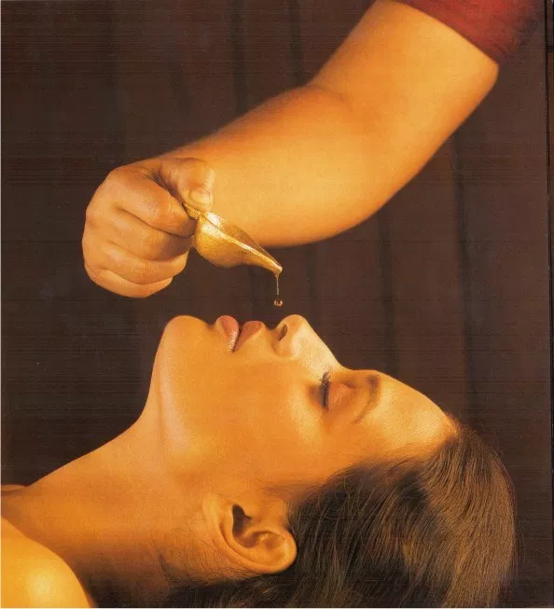
SHIROVIRECHANA
DR. PRETYA JUYAL
ASSISTANT PROFESSOR
DEPARTMENT OF PANCHAKARMA
KSVAMC & RC, GANGOH

Slide 2
NASYA- THERAPEUTIC EFFECT

Slide 3
NASYA- WHEN & WHERE
ACCORDING TO SEASON

Slide 4
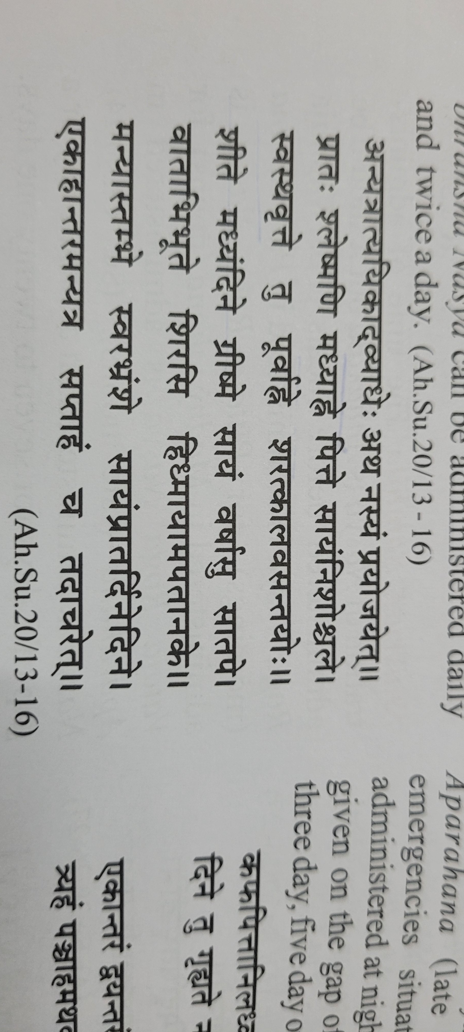
ACCORDING TO DOSHA

Slide 5
DURATION
ACHARYA | DAYS
Sushruta | 1,2,7,21
Vagbhatta | 3,5,7,8
Bhoj | 9

Slide 6
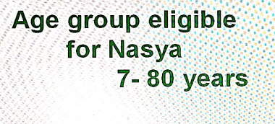
AGE LIMIT (A.H.SU.20/30)

Slide 7
BINDU

Slide 10
DOSE
TYPE OF NASYA | DOSE (Bindu)
 | Hina | Madhyam | Uttam
Snehana nasya | 8 | 16 | 32
Shodhana nasya | 4 | 6 | 8
Marsha nasya | 6 | 8 | 10
Avapida nasya | 4 | 6 | 8
Pratimarsha nasya | 2 | 2 | 2

Slide 11
CONT..

Slide 12
CLASSICAL DOSE

Slide 13
PRATIMARSHA NASYA

Slide 15
PRATIMARSHA KALA- 15 (Sushrut-14)

Slide 16
CONT….

Slide 17
INDICATION

Slide 18
CONTRAINDICATION

Slide 19
TYPES OF NASYA
Brimhana Nasya

Slide 20
2. Virechana nasya

Slide 22
NAVANA NASYA
Snehana
Shodhana
INDICATION OF SHODHANA NASYA

Slide 23
INDICATION OF SNEHANA NASYA

Slide 24
PROCEDURE

Slide 25
PAKA FOR NASYA

Slide 26
LIPOPHILICITY

Slide 27
MEDICINE PREPARATION

Slide 28
COURSE OF NASYA

Slide 29
TWICE DAILY IN?

Slide 30
DOSE

Slide 31
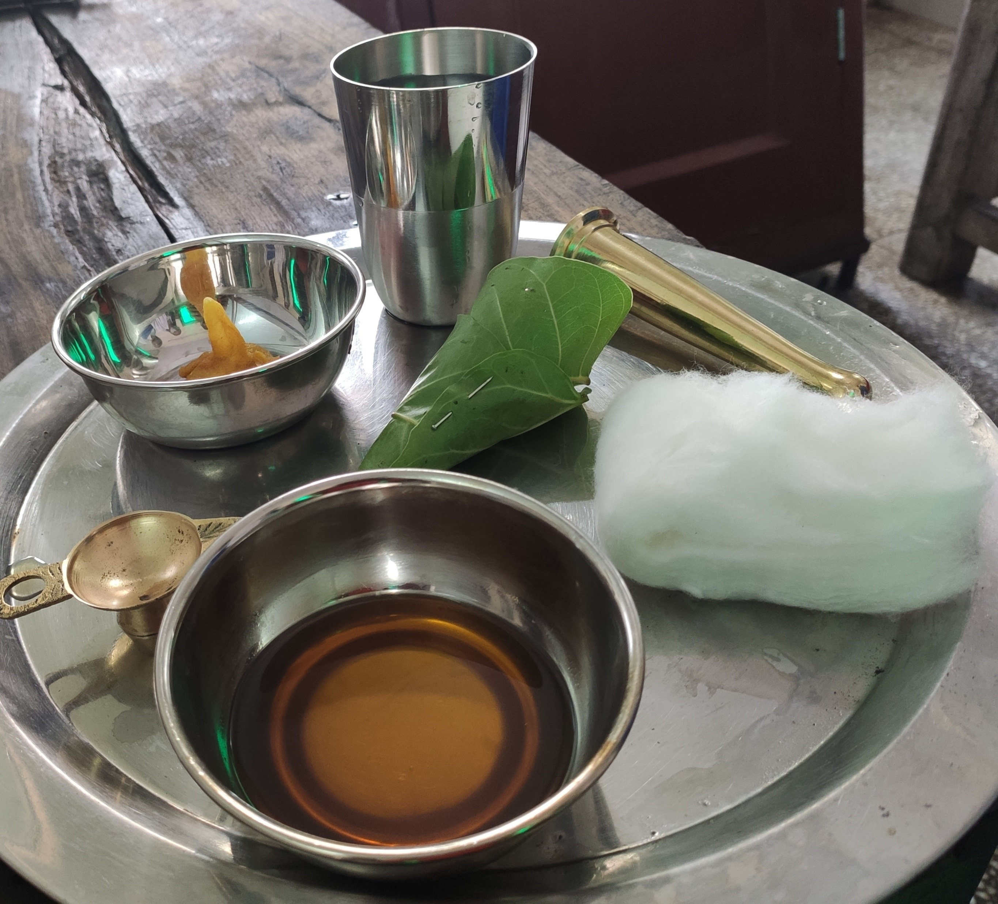
PRADHANA KARMA

Slide 32
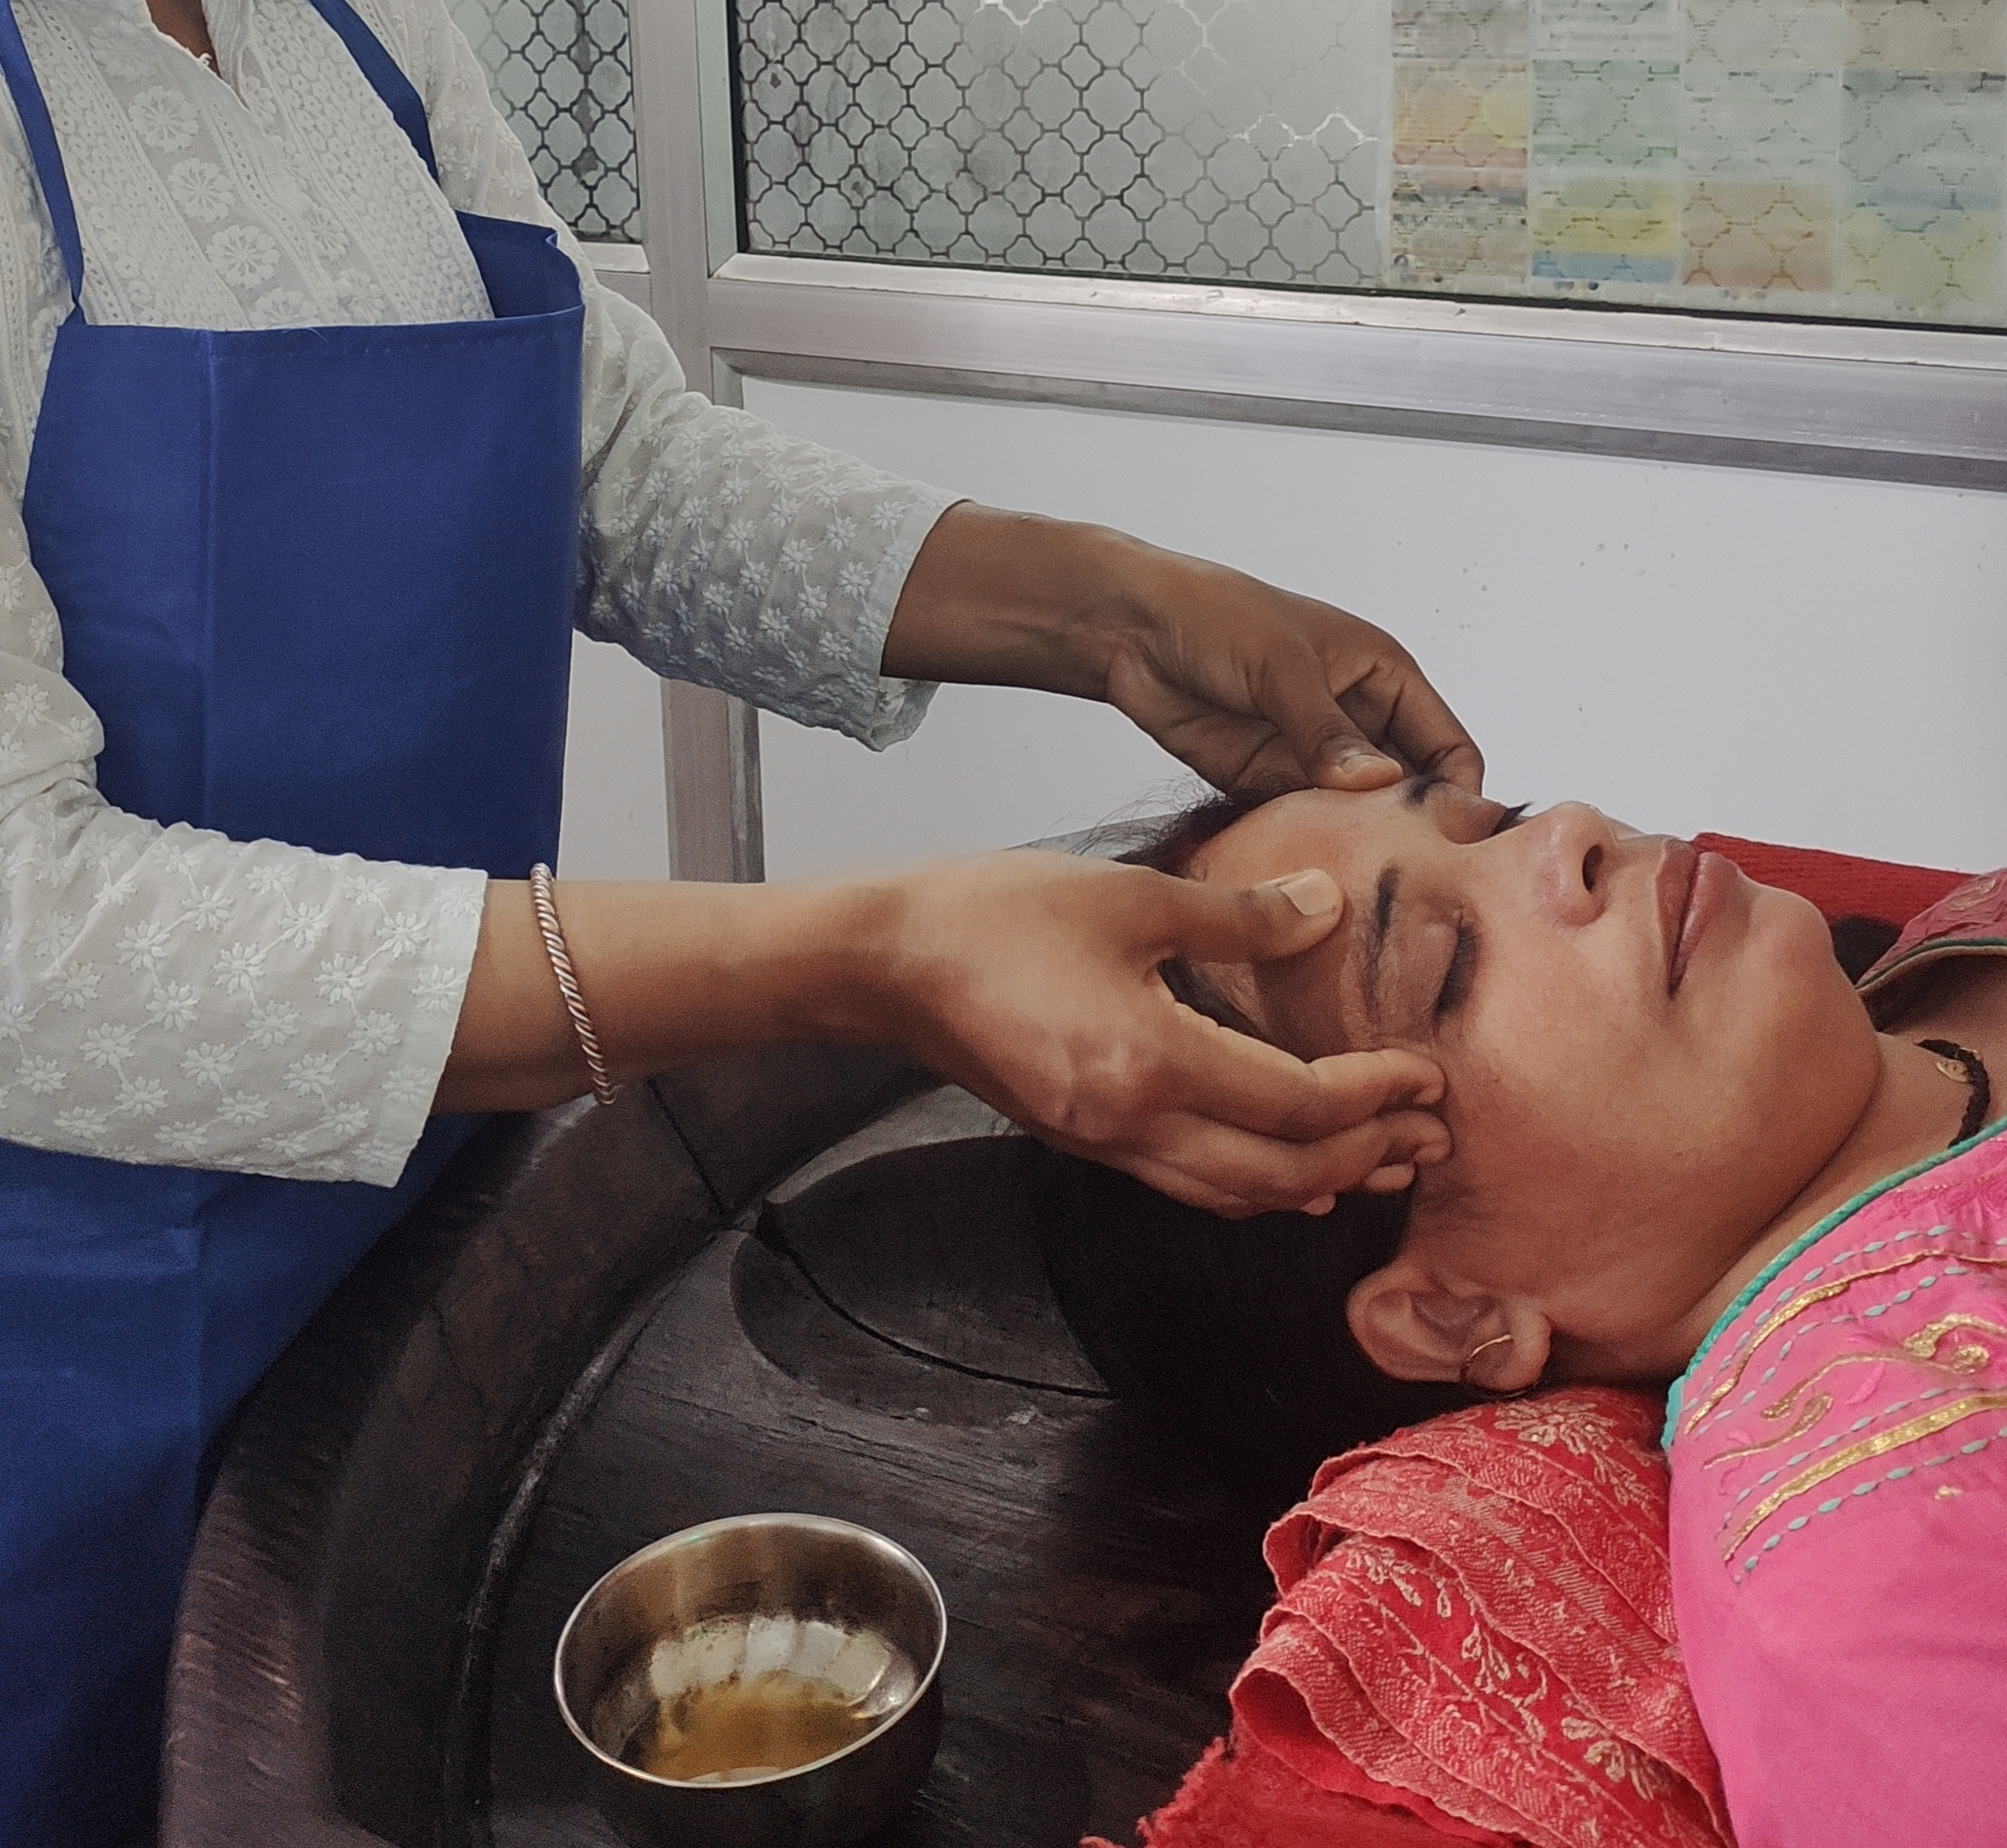
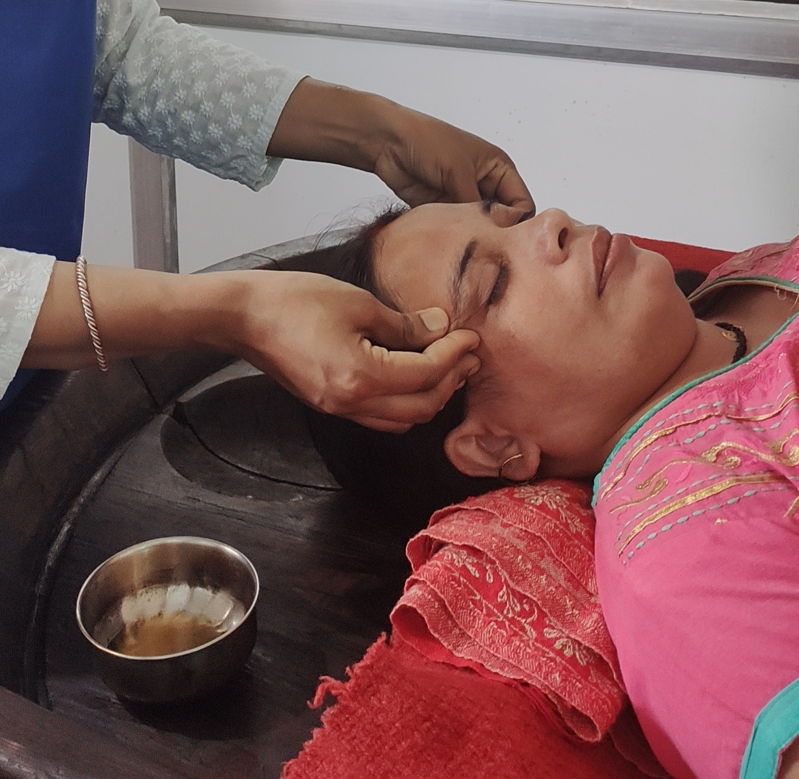

Slide 33
DHARANA KALA

Slide 34
NISHTHEEVANA

Slide 35
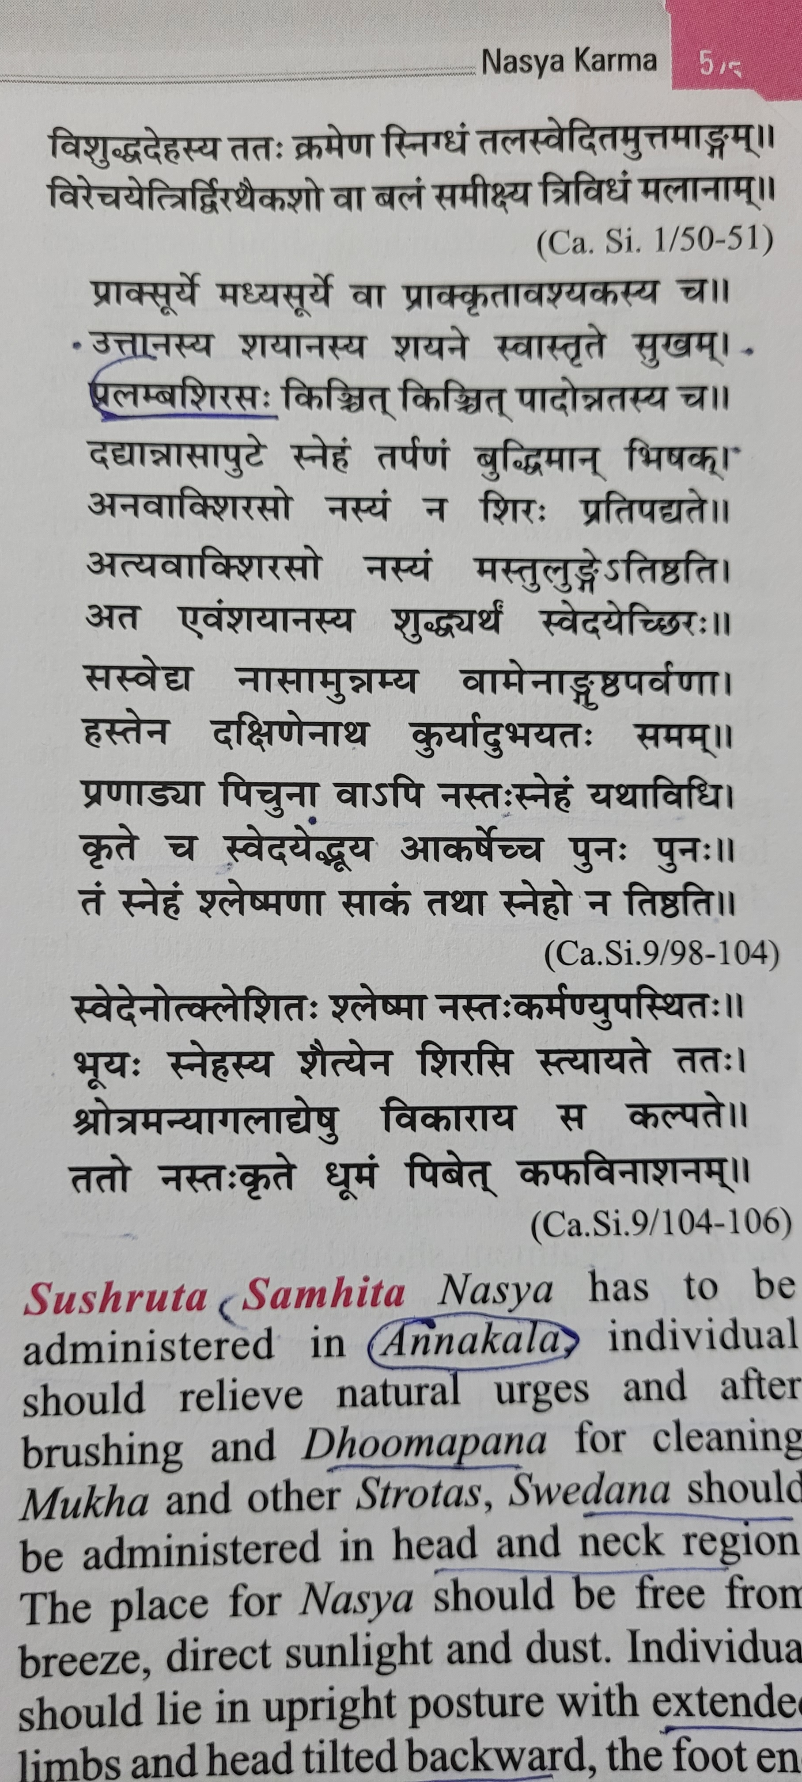
NASYA

Slide 38
